Slide 1


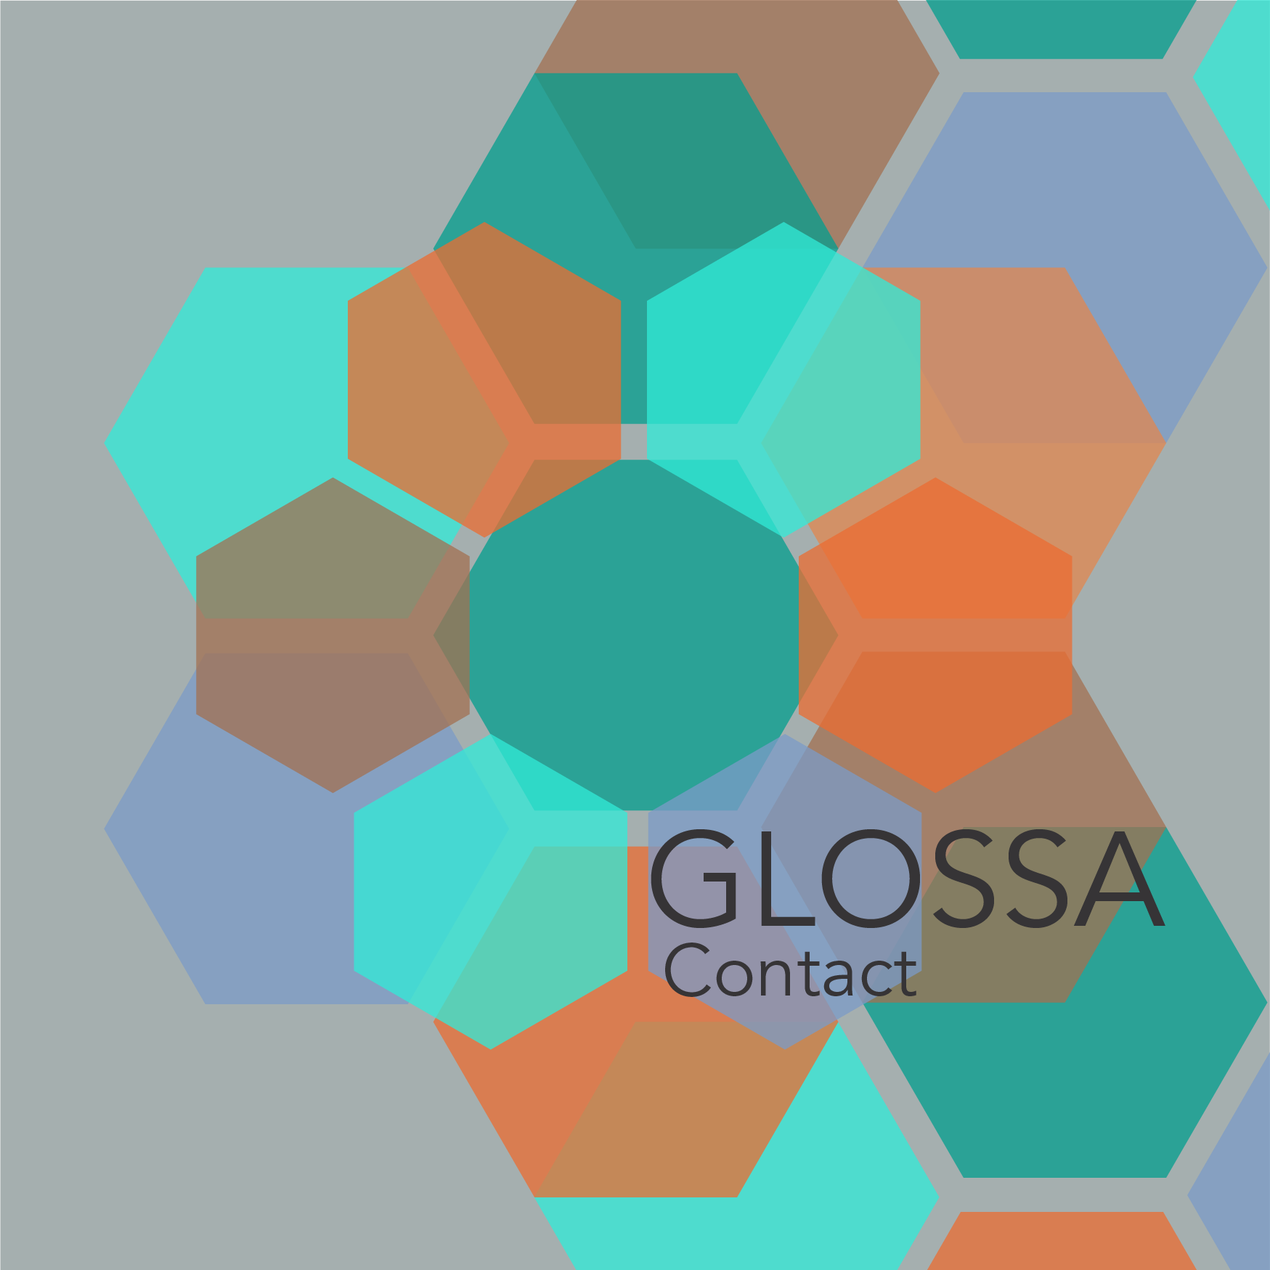
Intralingual & Interlingual Translations
Nikolaos Lavidas et al. • 75 min • 40 slides

Slide 2
Session Roadmap
Foundations
Intralingual lenses
Interlingual contrasts
Integration + labs

Slide 3
Motivation
Translations as laboratories for change
Capture both rapid and gradual shifts
Bridge philology and NLP

Slide 4
Key Questions
Do intra/inter contact trigger distinct syntactic effects?
How do genre + prestige mediate change?
Which corpora scale best?

Slide 5
Corpus Ecosystem
Original canonical works
Passive vs active retranslations
Parallel alignment per era

Slide 6
Method Stack
PROIEL dependency schema
Stanza NLP integration
Graph-based text family modeling

Slide 7
AthDGC Pipeline
Data ingestion
Annotation + QA
Visualization & release

Slide 8
Lavidas Legacy
Timeline of prior findings
Key publications
Open questions carried forward

Slide 9
Defining Intra vs Inter
Intralingual = historical varieties
Interlingual = cross-language
AthDGC traces inter- and intralingual contact via translation chains, leveraging PROIEL dependency annotation and contrastive parsing across three millennia.

Slide 10
Intralingual Overview
Registers, dialects, standards
Retranslation chains as data
Passive vs active motivations

Slide 11
Case: Byzantine Paraphrases
Periphrasis tracking
Shift in valency patterns
Question: continuity or innovation?

Slide 12
Case: Modern Greek Liturgical Updates
Register leveling
Lexical modernization cues
Sociolinguistic drivers

Slide 13
Quant Signals
Frequency deltas for constructions
Argument structure variation charts
Visualization per century

Slide 14
Qual Insights
Semantic bleaching traces
Calque avoidance narratives
Role of scribal norms

Slide 15
Impact on Valency Lexica
New senses triggered
Frame-synset alignment
Feedback to lexicon builders

Slide 16
Pedagogical Tie-ins
Teaching historical Greek
Translators' craft workshops
Community annotation events

Slide 17
Reflection Poll
Which intralingual dataset should expand first?
Prompt QR live poll
Discuss in pairs

Slide 18
Checkpoint
Summarize intralingual takeaways
Flag open data requests
Transition to interlingual focus

Slide 19
Interlingual Landscape
Hebrew ↔ Greek ↔ Latin
Romance & English receptions
Missionary + scholarly channels

Slide 20
Historical Translation Movements
Septuagint to Vulgate
Renaissance humanist editions
Modern vernacular drives

Slide 21
Hebrew→Greek Contact
Septuagint calques
Case marking reshaping
Prepositional innovations

Slide 22
Latin→Greek Dialogues
Late Antique borrowings
Passive participle shifts
Prestige pressure

Slide 23
Romance & English
Modern missionary corpora
Semantic field expansion
Orthographic considerations

Slide 24
Genre Sensitivity
Legal vs liturgical vs narrative
Translation brief matters
Stability vs experimentation

Slide 25
Syntactic Patterns
Argument realization changes
Clause chaining
Periphrasis adoption

Slide 26
Sociolinguistic Drivers
Authority of source text
Community reception
Censorship + orthodoxy

Slide 27
Visualization Slide
Network of source-target nodes
Color by language
Edge weight = retranslation density

Slide 28
Comparative Table
Intralingual vs interlingual metrics
Stability index
Change acceleration ratio

Slide 29
Audience Question
Where do you expect faster change?
Vote live
Collect rationales

Slide 30
Integration
Translation as change accelerant
Detect decelerators (standardization)
Predict hotspots

Slide 31
Tooling Demo
Graph-based explorer
Query syntax screenshot
Export features

Slide 32
Challenges
Alignment noise
Metadata gaps
Interpretive disagreements

Slide 33
Mitigation
Community QA days
Metadata templates
Contextual glossaries

Slide 34
Hands-on Lab Plan
Allocate teams to specific translation chains
Define quick wins for intralingual vs interlingual tasks
Schedule report-outs for Saturday tech block

Slide 35
Lavidas et al. Abstract
Contrastive parsing across three millennia
PROIEL tracks adaptation to Hebrew/Latin/Romance
Statistical analysis separates rapid vs gradual change

Slide 36
ARCAS Collaboration
Shared infrastructure Harvard CHS
Classical philology + computational methods
Joint annotation frameworks benefit community

Slide 37
Future Outputs
Open treebanks
Comparative datasets
Training parsers

Slide 38
Collaboration Invites
Bring corpora
Share scripts
Mentor students

Slide 39
Discussion Prompts
Which translation chain to prioritize?
How to handle contested editions?
What tooling is missing?

Slide 40
Closing Slide
Thanks + contact links
QR to shared folder
Next session preview

